Slide 1

USB Subsystem in Zephyr
For nRF52840 DK

Slide 2
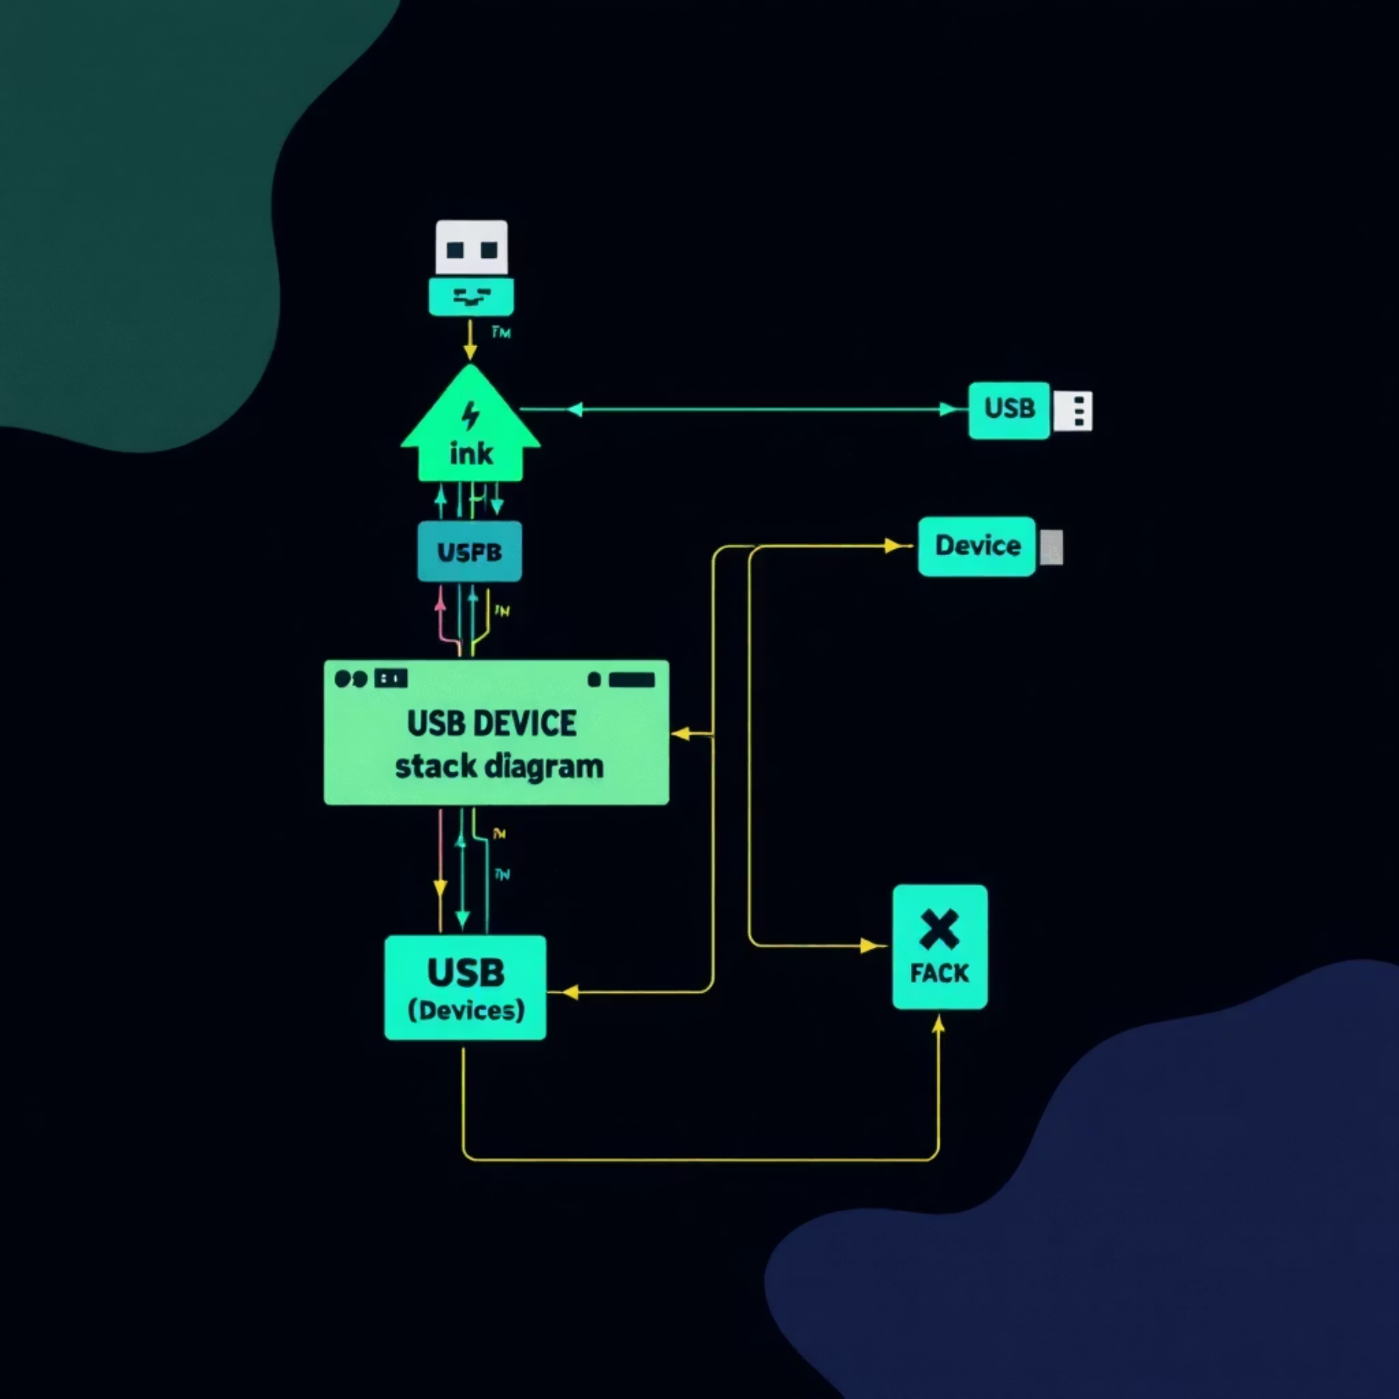
USB in Zephyr
Zephyr provides USB device functionality
CDC ACM (serial)
HID (input devices)
RNDIS (networking)
Mass Storage

Slide 3




Common USB Use Cases
Serial (CDC ACM)
Input Devices (HID)
Virtual COM port for device communication
Keyboards, mice, custom controllers
Networking
Firmware Updates
ECM/RNDIS for IP communication
DFU for over-USB updates

Slide 4
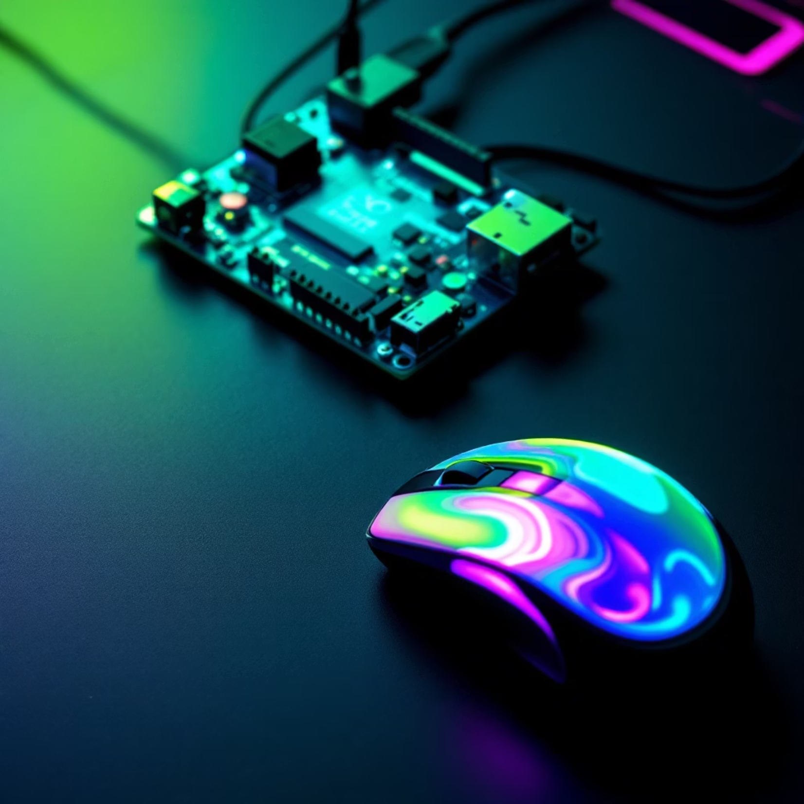
HID Sample Overview
Human Interface Device
Path: samples/subsys/usb/hid-mouse
Simulates mouse movement
Appears as standard HID device

Slide 5

Building HID Sample
west build -b nrf52840dk/nrf52840 \ samples/subsys/usb/hid-mousewest flash

Slide 6

RNDIS Overview
Remote Network Driver Interface
Device appears as Ethernet adapter on host
Enables IP networking over USB

Slide 7
Creating RNDIS App
Modify project structure
Remove unneeded files
Copy HID sample as starting point
README
.yaml file
usbd_next_prj.conf

Slide 8
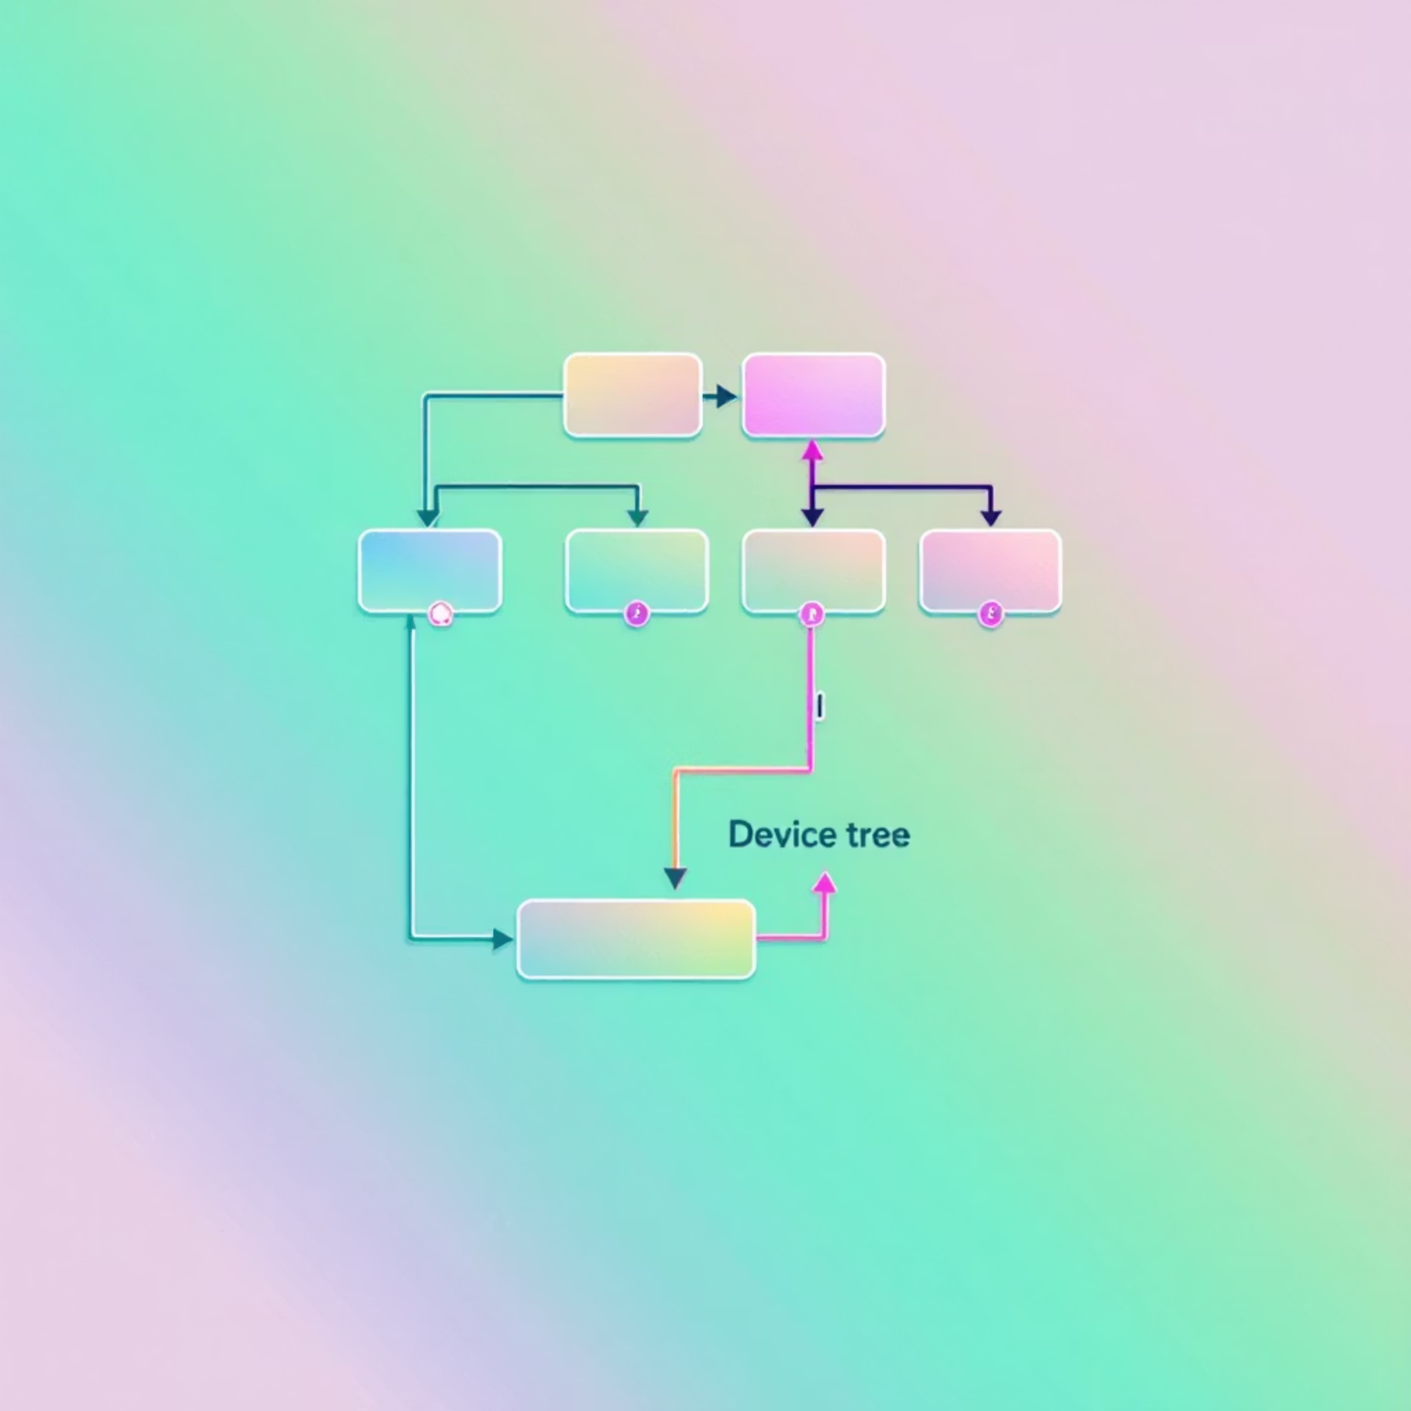
Device Tree Configuration
Update CMakeLists.txt
Change project name to rndis
Create .overlay file
&zephyr_udc0 { rndis_func: rndis { compatible = "zephyr,usb-rndis"; };};

Slide 9
Implementation Details
Use the files main.c to create network interface
Use the file prj.conf to enable all the relevant configs

Slide 10




Testing the Demo
Build & Flash
Verify Connection
Deploy to nRF52840
Check dmesg and ip addr
Configure IP
Test Connection
Set host to 2.2.2.1/24
Ping in both directions

Slide 11
Telnet
Add telnet server as backend in prj.conf
CONFIG_SHELL_BACKEND_TELNET=y
CONFIG_SHELL_TELNET_SUPPORT_COMMAND=y
Connect from the host to telnet and run the shell
Telnet 2.2.2.2

